Slide 1
Generating Area-based recommendations regarding the category of Restaurants to open in Mumbai
Kaustav Sadhukhan

Slide 2
Business Problem and Target Audience
Opening the right-type of restaurant serving the particular category of cuisine is very important for anyone who wants to start a new business venture in terms of restaurants.
The target audience for this project includes any new food chain who is interested in starting a new business venture in the city of Mumbai and wishes to have recommendations regarding which particular cuisine or which particular food item they should serve in their outlets based on the particular Area in Mumbai where they are planning to set up their new outlets.

Slide 3
Data Acquisition and Cleaning
Area , Location and Co-Ordinates of Mumbai are obtained from web-scraping the below url:-
https://en.wikipedia.org/wiki/List_of_neighbourhoods_in_Mumbai
We have also used Python’s geopy package to obtain the latitude and longitude of all the Areas of Mumbai and generated the map of Mumbai with locations superimposed on them using folium.
Finally we use Four Square API to generate nearby venues and their categories for a particular Area of Mumbai.
This data is cleansed pre-processed and conditioned into a data frame to obtain the 10 most popular venues for each Area which is then used for clustering the Areas based on the popularity of venues.

Slide 4
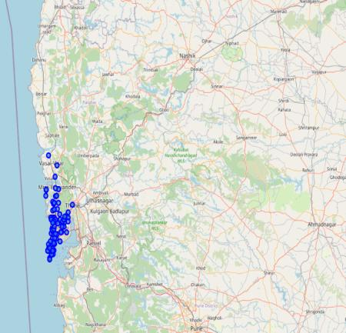
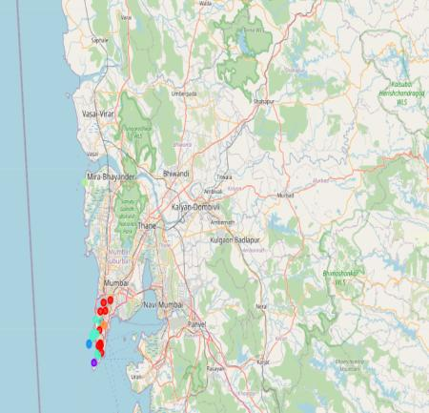
Generating the maps of Mumbai using Folium and Geopy package of python.
Using the folium and Geopy we plot the map of Mumbai with locations superimposed on top.
After clustering of the Areas in South Mumbai with respect to the most popular venues.

Slide 5
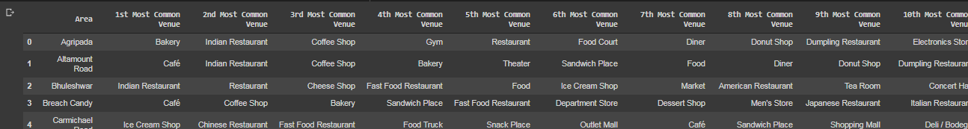
Final cleaned and pre-processed dataset used for Clustering

Slide 6
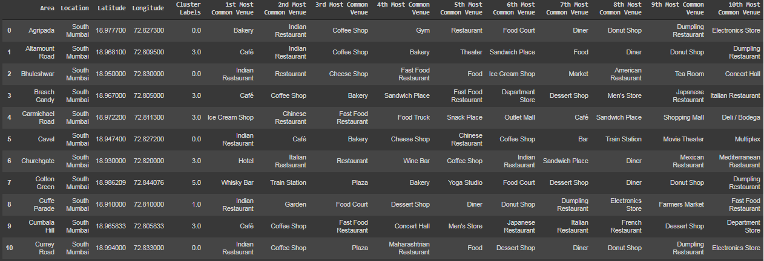
Clustering Results

Slide 7
Discussion
A very important observation that surfaces from the above analysis is that if we take a closer look at the different clusters we find that in Cluster 1 the first most common venue is “Indian Restaurants” and the second and third most common venues are mainly Coffee Shops, Bakeries, Café’s, Pizza Corners and other fast food restaurants. So, it is very clear that people residing in Cluster 1 areas have a special liking or prefer Indian cuisine over other cuisines. But, at the same time since this cluster has a high density of Indian Restaurants as their most popular venue, so keeping in mind the tough competition from other popular food joints any new business venture should be a bit cautious in serving Indian cuisine in these areas. But if they can improvise their menu to serve quality Indian food items or add some newer items and can lower the rates, then they can attract these customers to dine at their joints.
If we examine Cluster 4, we find mostly Cafe’s, Ice Cream Shops, Coffee Shops and Bakery as the most popular venues. So, it is very clear that people residing in Cluster 4 areas have a special liking or prefer light refreshments over heavy course meals. So, going by the above analysis, it will be quite advantageous for any new food chain to open these kinds of light food joints in the areas that fall within this cluster. But if they want to avoid competition from other vendors they can as well open up Indian Restaurants as there are very few restaurants serving Indian Cuisine in these areas.

Slide 8
Conclusion and Future Scope
All these analyses will be of great help for any new food chain which wants to start operation in Mumbai, they can decide well on their business strategy to maximize their ROI by avoiding stiff competition as well as catering to the preferences of people residing in a particular Area.
This analysis can be further extended to other locations of Mumbai like Andheri, Western Suburbs, Mira-Bhayandar, Western Suburbs, Bandra, Western Suburbs, Kandivali East, Western Suburbs etc.

